Slide 1
Project: Mapletree Logistics Hub, Port of Tanjung Pelepas-Johor
Category: Commercial
Division: Epoxy Flooring
Mapei solutions are applied in construction sites all around the world, everyday

Slide 2
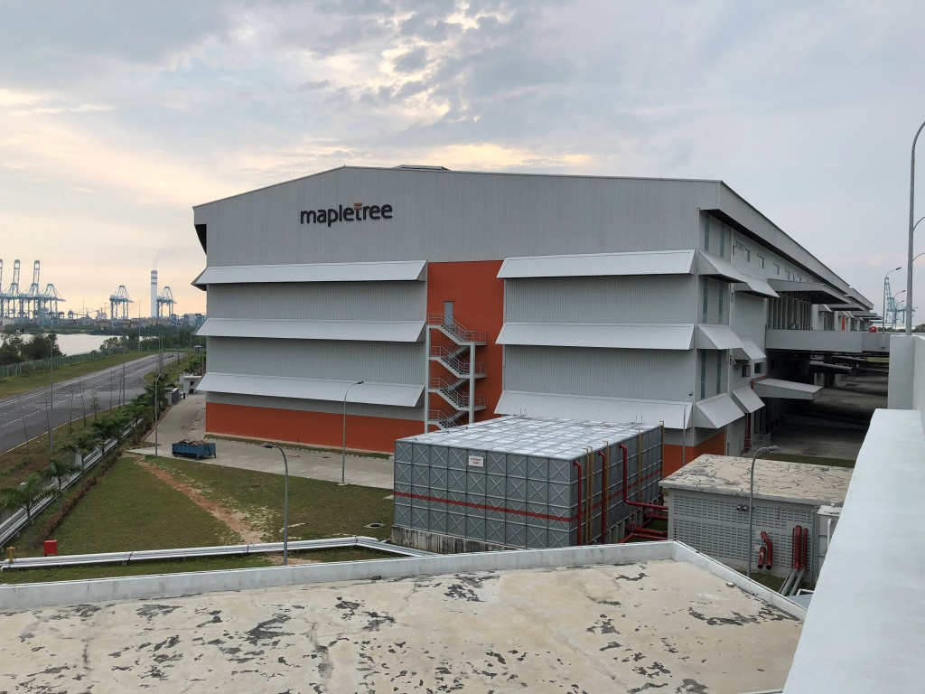
Malaysia, Mapletree Logistics Hub
Mapletree Logistics Hub, Port of Tanjung Pelepas-Johor
MLH-2
About Mapletree Logistics Hub
Mapletree Logistics Trust (MLT) is a real estate investment trust which owns a diversified portfolio of logistics warehouses in Singapore, Japan, China, South Korea, Vietnam, Australia, Hong Kong and Malaysia.
This new logistics hub comprises three blocks of double-storey industrial warehouses and one office block, with a total gross floor area of about 110,000 square metres. It is designed with high building specifications and uses pre-stressed structural concrete sections.
The Port of Tanjung Pelepas lies within Iskandar Malaysia, which was established in 2006 as the main southern development corridor in the state of Johor.

Slide 3
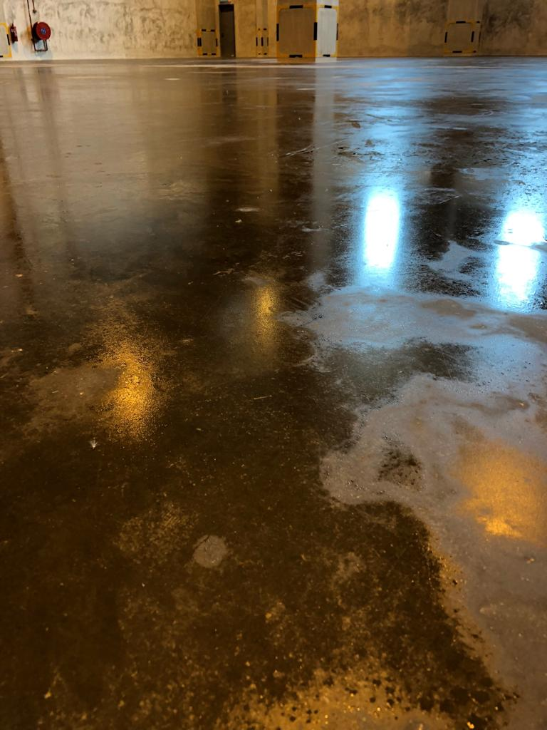
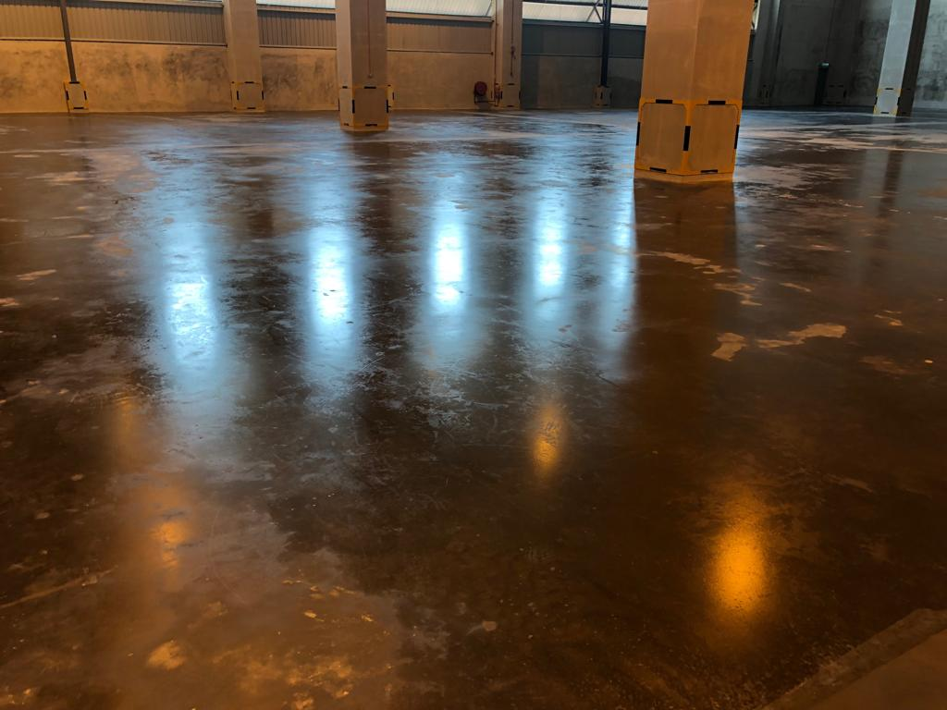
Malaysia, Mapletree Logistics Hub
Mapletree Logistics Hub, PTP-Johor
The Project Needs
The ground and first floor slabs of the newly-built warehouses, originally finished with dry shake hardeners (by a competitor), suffered the problem of “sweating”. Dampness appeared on the floors without any obvious reason.
The owner of the property needed a solution and invited proposals from principal flooring companies. As part of the evaluation, Mapei Malaysia was invited to perform a trial application on a small area along with other competitors.
The key selection criteria for the flooring solution were:
Effective and durable solution to “sweating” problems
Able to complete installation of 110,000 m² in 6 months
Close attendance & technical support by a competent principal.
“sweating” floors

Slide 4
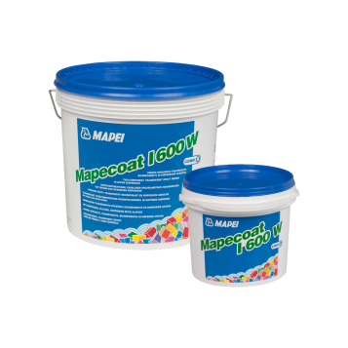
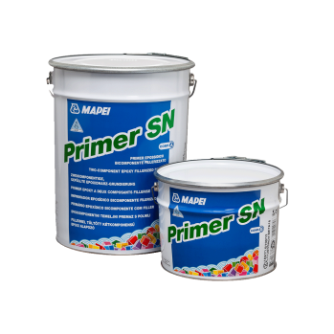
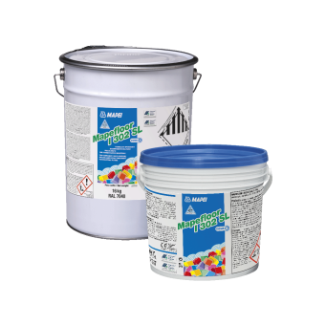
Malaysia, Mapletree Logistics Hub
Mapletree Logistics Hub, PTP-Johor
The Proposed Solution & why MAPEI was selected
MAPEI proposed a high-wearing epoxy flooring system with a moisture-barrier underlay as described in the table.
Finally the MAPEI solution was selected based on:
The successful on-site trial results,
The proposal to use 3 experienced applicators to carry out the rush programme; installing 110,000 m² over 6 months,
Confidence in MAPEI’s technical competence and support gained over many presentations and meetings with the clients.
The MAPEI Solution & project dimensions
MAPEI Product | Function | Area
a) Mapecoat I 600 W | Priming coat on concrete | 110,000m²
b) Triblock TMB | Temporary moisture barrier
c) Primer SN | Permanent moisture barrier
d) Mapefloor I 302 L | Wearing layer

Slide 5
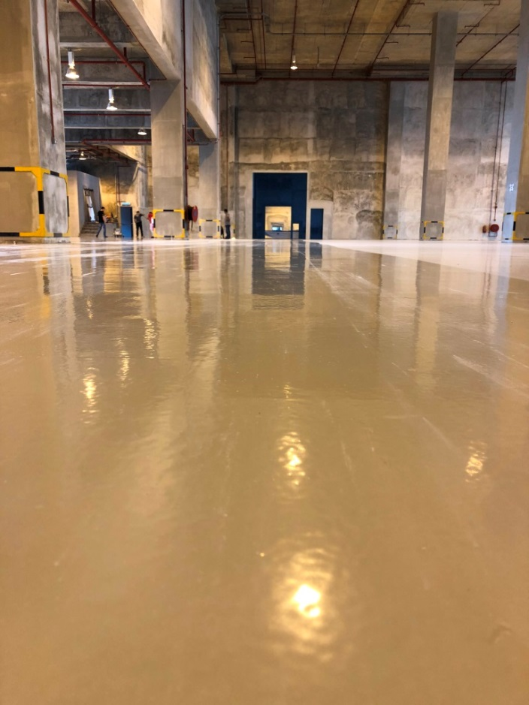
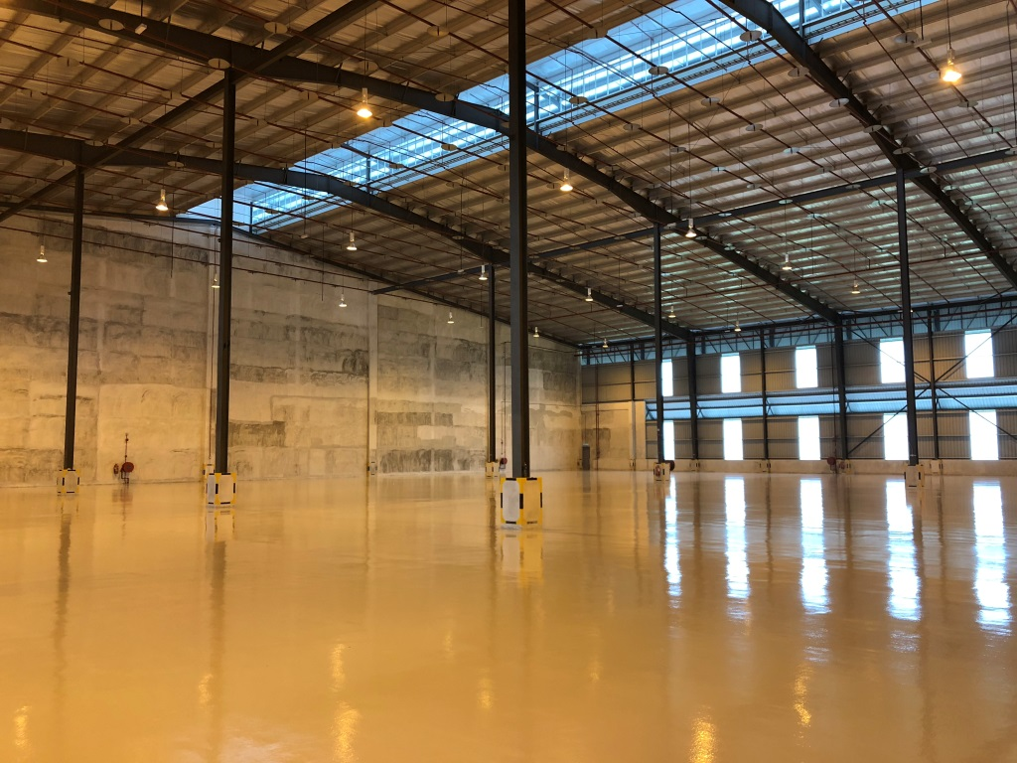
Malaysia, Mapletree Logistics Hub
Mapletree Logistics Hub, PTP-Johor
Foot traffic after 1 day’s curing
Picture, works completed…
MLH-20
Completed flooring works
MLH-21

Slide 6
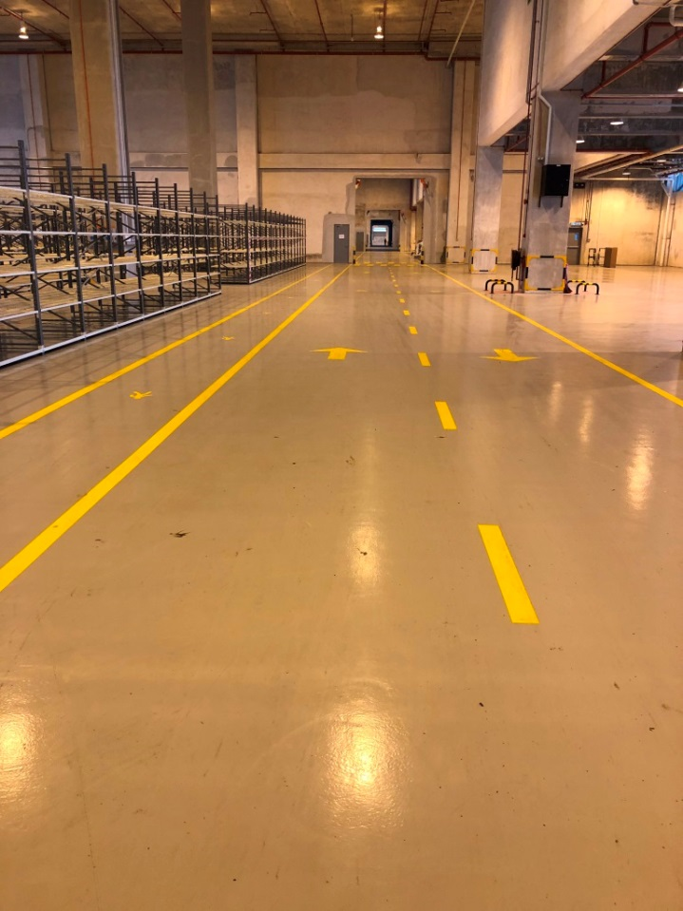
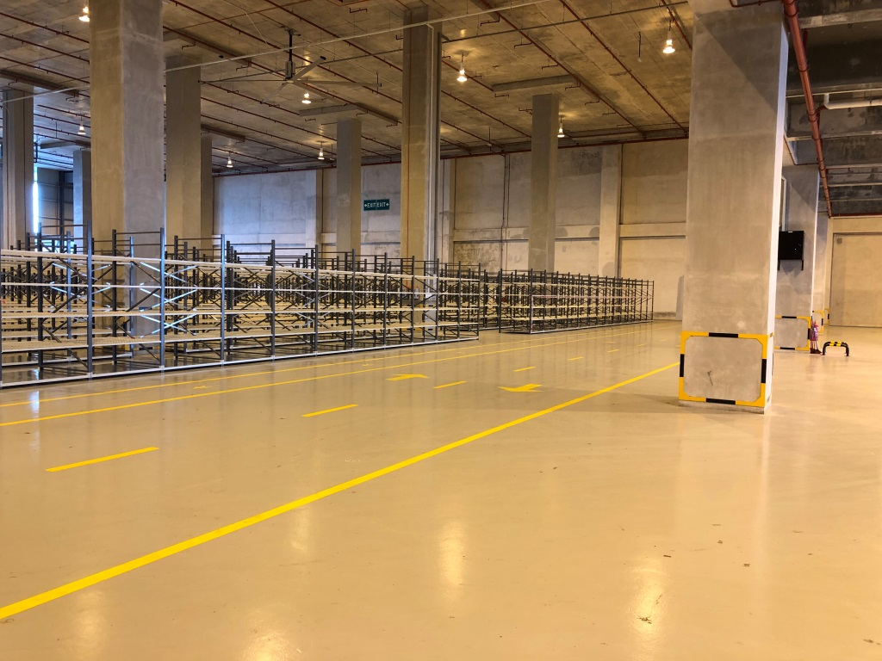
Malaysia, Mapletree Logistics Hub
Mapletree Logistics Hub, PTP-Johor
Picture, works completed…
MLH-22
MLH-23
Completed flooring works

Slide 7
We thank you
for your attention
www.mapei.com.my

